Slide 1

Notes:
[Sources]
- C:/Users/oehle/Documents/investment-course/lesson-01/Lesson 01 - What is investment - handout v2.docx
- https://www.apec2026.cn/node_196.html
[/Sources]

Slide 2

Notes:
First judgement: students choose yes or no, then name the information they would need. Do not introduce the labels investment, speculation or saving yet. Return to this decision on slide 24.
[Sources]
- C:/Users/oehle/Documents/igcse-term-outlines/outputs/investment-course-one-semester/Investment and Financial Decision-Making - 2026-27 Semester 1 Bilingual Department Leadership Learning Summary.pdf
- C:/Users/oehle/Documents/investment-course/lesson-01/Lesson 01 - What is investment - handout v2.docx
- https://www.pexels.com/photo/smartphone-displaying-stock-trading-app-interface-28682345/
[/Sources]

Slide 3

Today
What is investment?
What is financial investment?
Distinguish between investment, saving and speculation.

Slide 4
1. What is investment?

Slide 5



Investment: using money or other resources now because you expect a future benefit

Slide 6
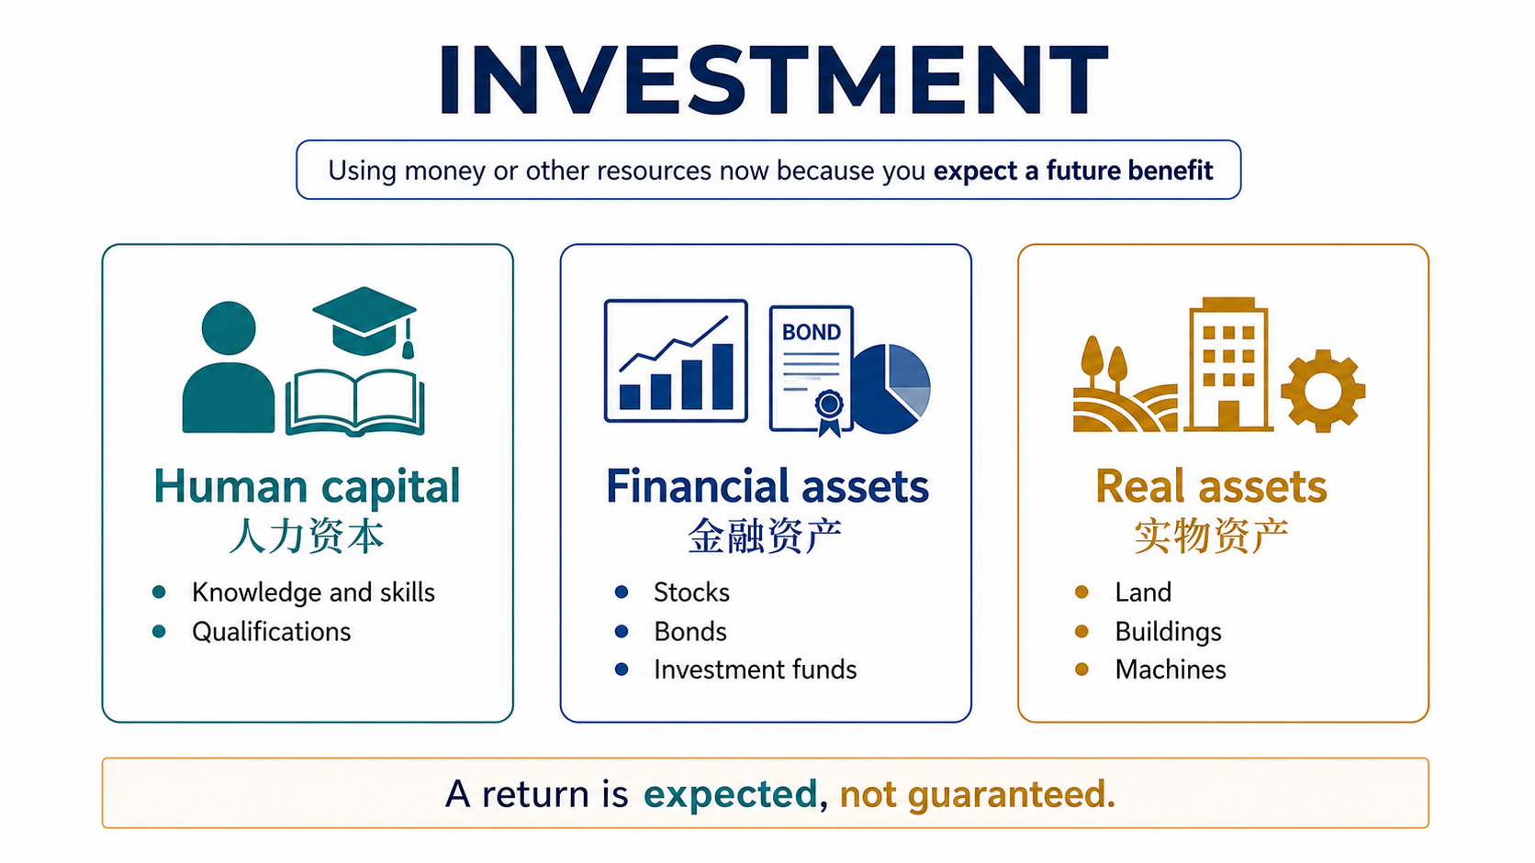

Slide 7
2. What is financial investment?

Slide 8
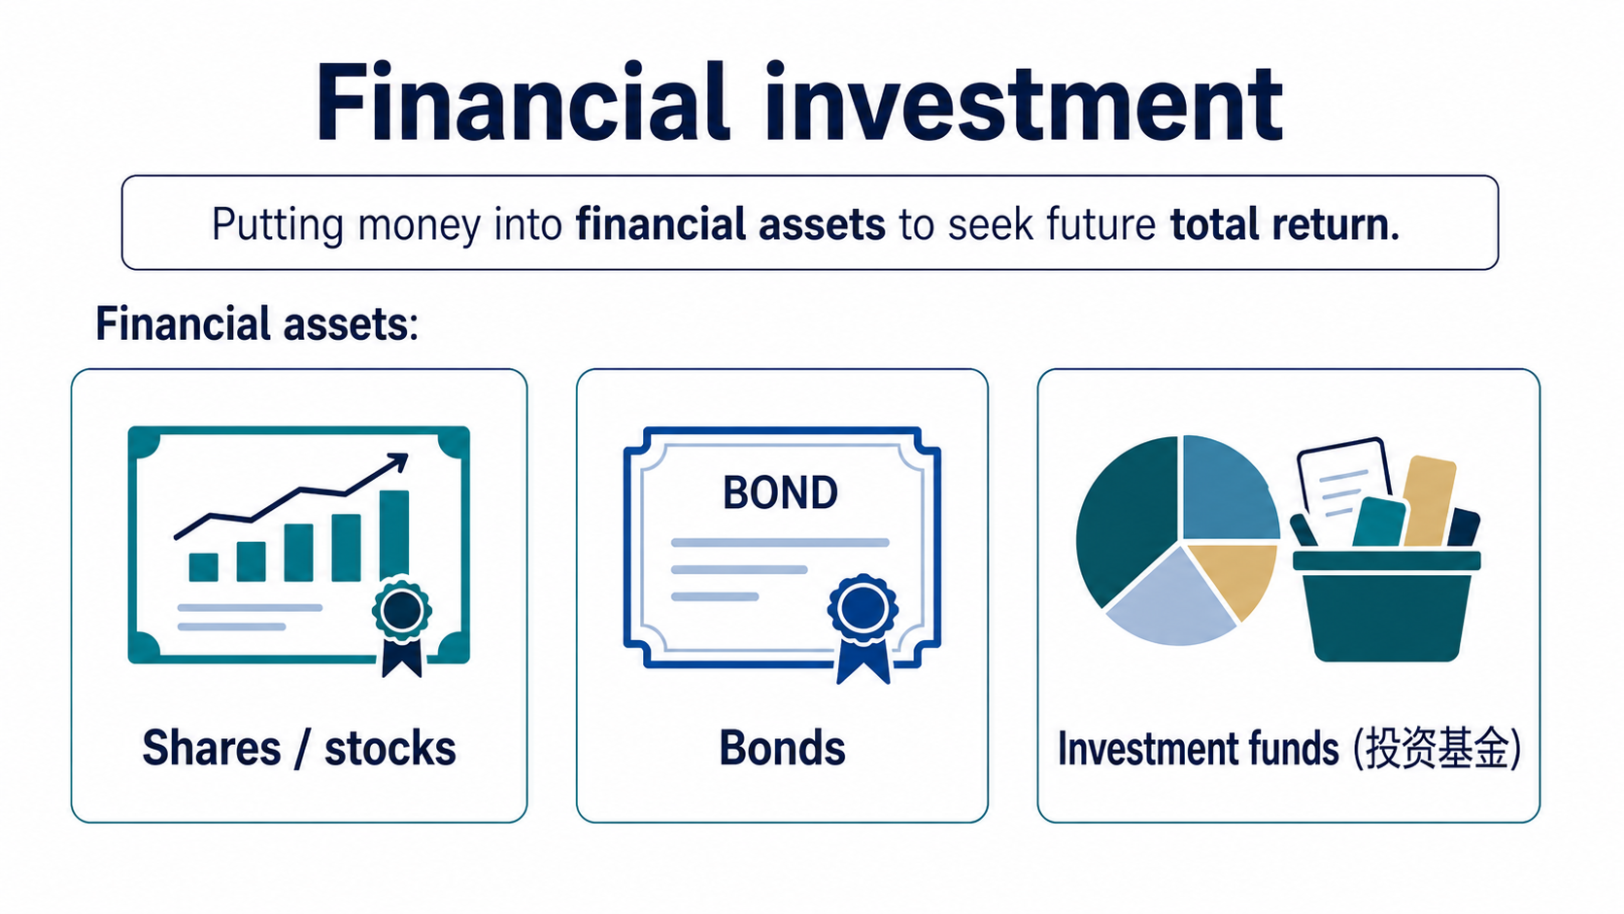

Slide 9
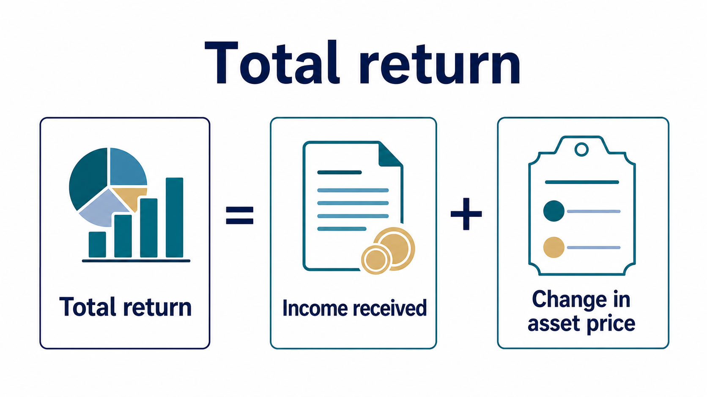

Slide 10
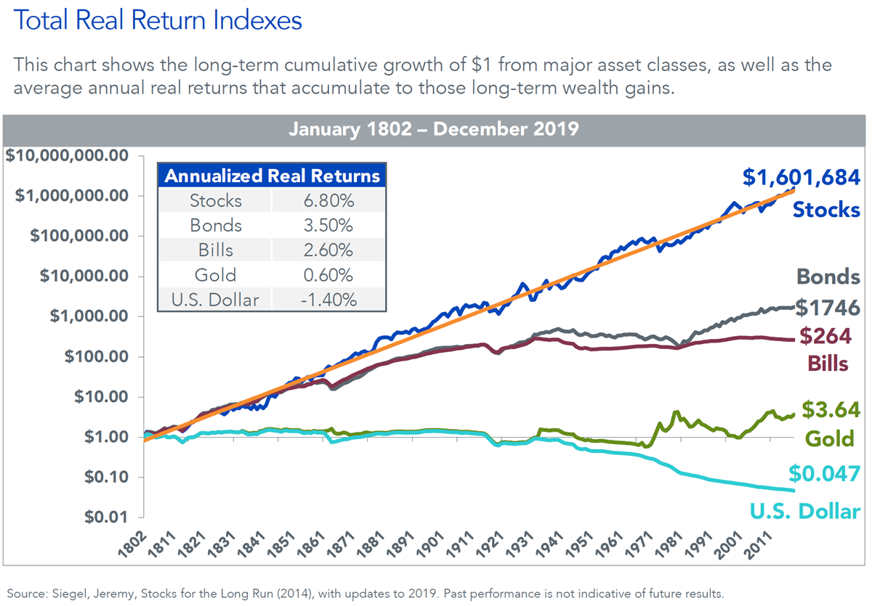

Slide 11
3. Distinguish between investment, saving and speculation.

Slide 12

Is this investment?
Notes:
[Sources]
- https://uk.finance.yahoo.com/news/investing-money-savings-risks-finances-050038406.html
[/Sources]

Slide 13
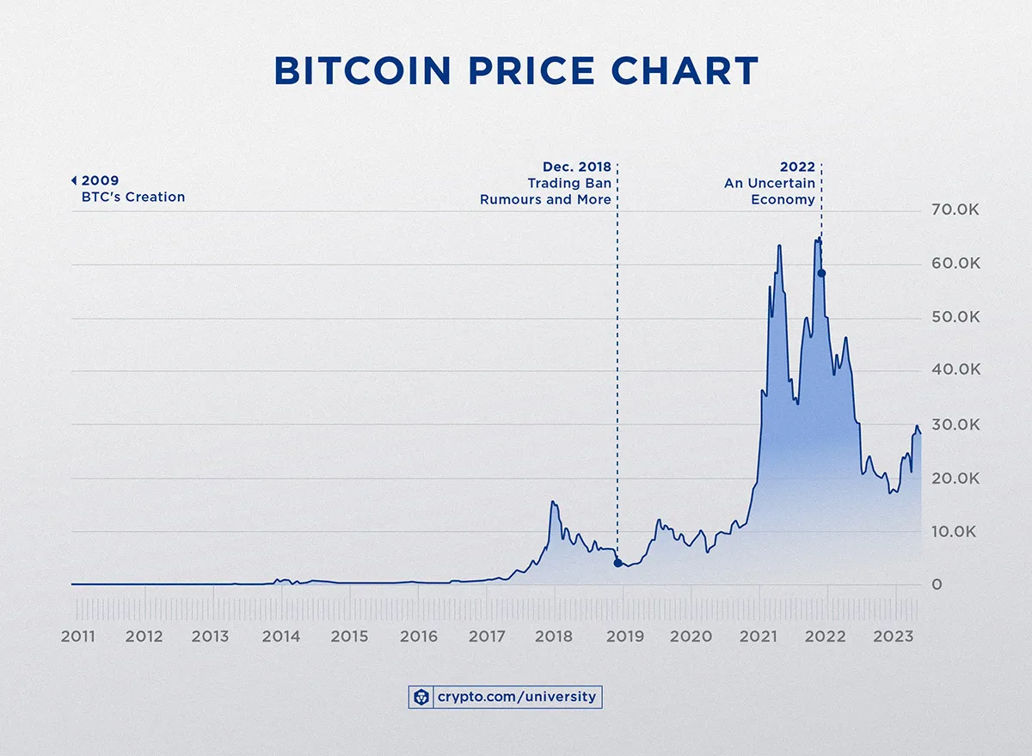

Slide 14
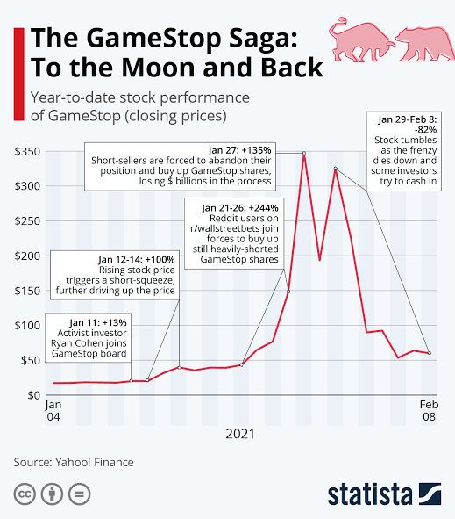

Slide 15
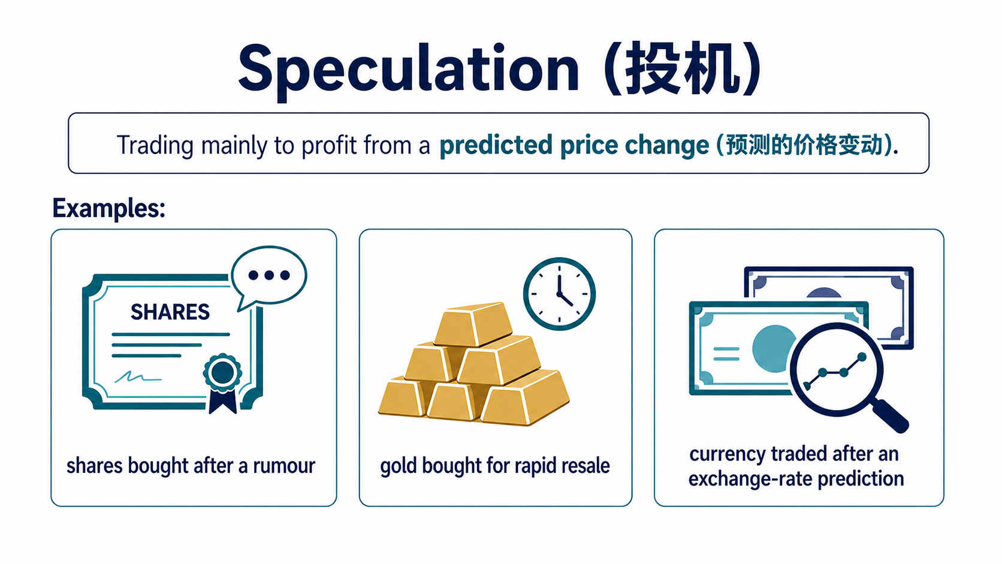

Slide 16
Explain the difference between financial investment and speculation.
Investment:
Focuses on total return: income plus growth in value
Often longer-term
Speculation
Focuses on price movement
Often shorter-term and involves greater risk

Slide 17
Explain the difference between financial investment and speculation.
Investment involves committing money to an asset to earn income, such as dividends or rent, and to benefit from an increase in its underlying value. It is therefore often based on the asset’s long-term performance.
In contrast, Speculation involves buying an asset to profit from an expected change in its market price. Speculation is often shorter-term and carries greater risk because the expected price movement may not occur.

Slide 18

Is this investment?
Notes:
[Sources]
- https://www.cnbc.com/2019/12/18/how-to-build-an-emergency-savings-fund.html
[/Sources]

Slide 19
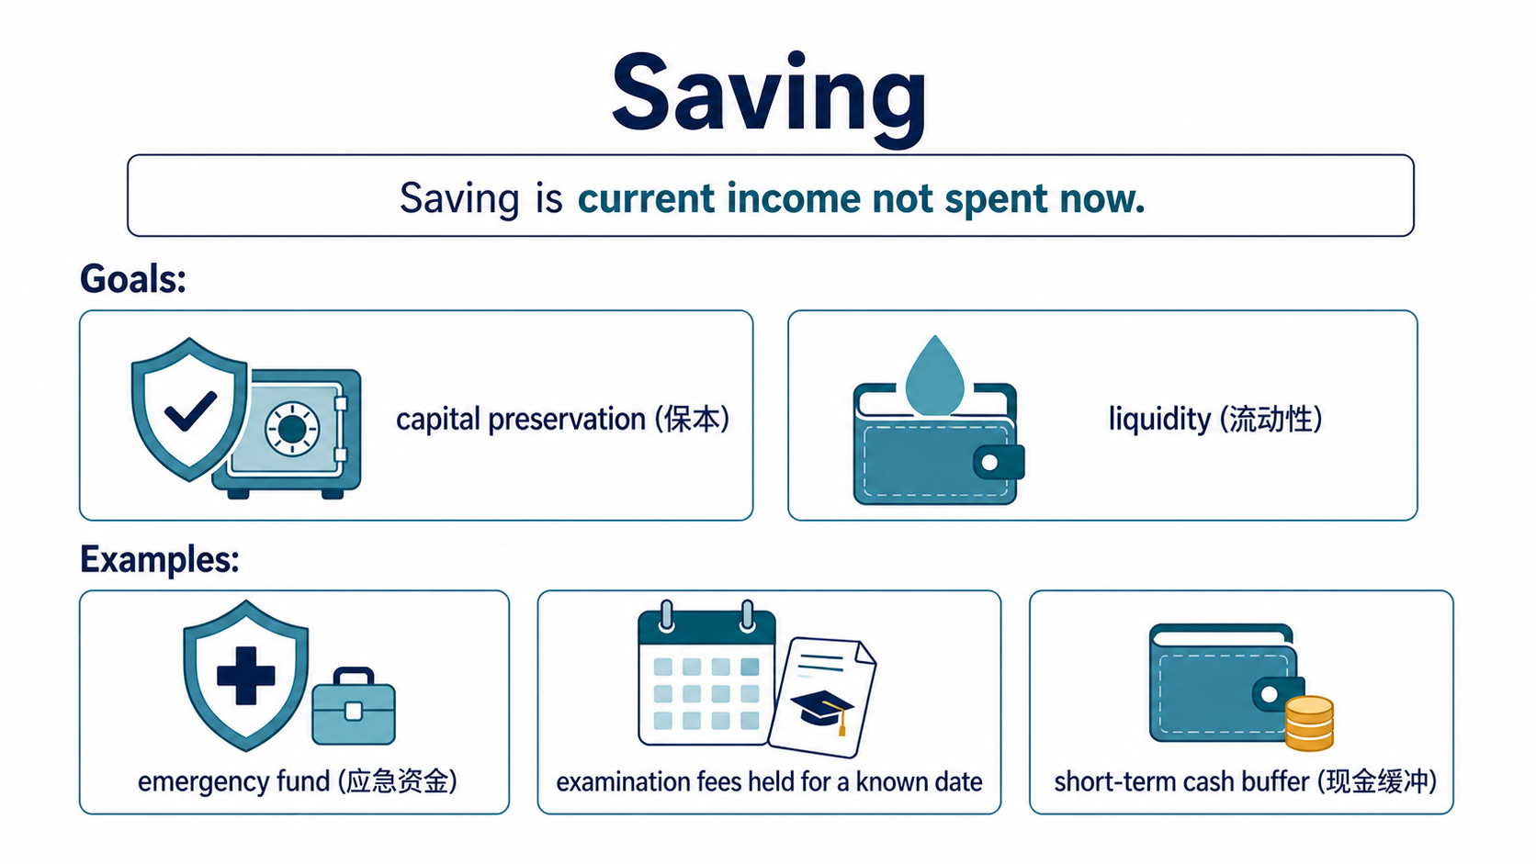

Saving
Saving is current income not spent now.
Goals:
• capital preservation (保本)
• liquidity (流动性)
Examples:
• emergency fund (应急资金)
• examination fees held for a known date
• short-term cash buffer (现金缓冲)
Notes:
[Sources]
- C:/Users/oehle/Documents/investment-course/lesson-01/Lesson 01 - What is investment - handout v2.docx
- https://www.lepoint.fr/eureka/pourquoi-les-tirelires-ont-elles-la-forme-d-un-cochon-27-09-2024-2571328_4706.php
[/Sources]

Slide 20
Explain the difference between financial investment and saving.
Investment involves committing money to an asset to earn income, such as dividends or rent, and to benefit from an increase in its underlying value.
In contrast, saving is the part of a person’s income that is not spent on current consumption. The money may be kept as cash or in a bank account for future use.
Financial investment generally involves more risk because the value of the asset may fall.

Slide 21
Exit ticket
What is investment?
What is financial investment?
List two financial assets.
List two non-financial assets.

Slide 22
Which is which?

Slide 23
Choose: Investment (投资), speculation (投机) or saving (储蓄)?
1. The main basis is expected income and/or evidence about underlying value; possible loss is accepted.
2. The main reason is a predicted price change; income or underlying value is not the main basis.
3. Money is kept mainly for a future need, safety and ready access.
4. Amina studies profits, cash flow and debt before buying a diversified share portfolio. She expects dividends and long-term price growth.
5. Bao borrows after an online rumour predicts a price rise next week. He will sell after an announcement.
Notes:
[Sources]
- C:/Users/oehle/Documents/investment-course/lesson-01/Lesson 01 - What is investment - handout v2.docx
[/Sources]

Slide 24
Choose: Investment (投资), speculation (投机) or saving (储蓄)?
6. Chloe estimates rent, maintenance and vacancy costs. She buys a flat mainly for net rental income.
7. Daniel needs examination-fee money in eight months, so he uses an easy-access account for safety and liquidity.
8. Eva invests for university in ten years using a diversified fund. She reviewed fees and risks and accepts a possible fall in market value.
9. Farah keeps an emergency fund in an easy-access account. Quick withdrawal matters more than return.
10. George buys a bond fund for retirement after checking interest income, credit risk, interest-rate risk and fees.
Notes:
[Sources]
- C:/Users/oehle/Documents/investment-course/lesson-01/Lesson 01 - What is investment - handout v2.docx
[/Sources]

Slide 25
Choose: Investment (投资), speculation (投机) or saving (储蓄)?
11. Hadi buys Bitcoin after an influencer predicts a weekend price jump. He will sell immediately if it happens.
12. Iris buys foreign currency before a central-bank announcement. Her expected gain depends on a price prediction.
13. Jun needs tuition money in three months, so he uses an easy-access account for safety and liquidity.
Notes:
[Sources]
- C:/Users/oehle/Documents/investment-course/lesson-01/Lesson 01 - What is investment - handout v2.docx
[/Sources]

Slide 26
MCQs

Slide 27
MCQ 1
What is the strongest evidence that a decision is a financial investment (金融投资)?
A. The asset has risen in price before.
B. The main basis is expected income and/or evidence about underlying value, while possible loss is accepted.
C. Money can be withdrawn immediately with no possible loss.
D. The buyer plans to sell after an unverified rumour.
Notes:
Answer: B. Decisive clue: the expected payoff is supported by income and/or evidence about underlying value, while possible loss is accepted.
[Sources]
- C:/Users/oehle/Documents/investment-course/lesson-01/Lesson 01 - What is investment - handout v2.docx
[/Sources]

Slide 28
MCQ 2
Which decision is saving (储蓄) rather than financial investment (金融投资)?
A. Keeping school-trip money in an easy-access account.
B. Buying a diversified fund for long-term growth after reviewing its fees and risks.
C. Buying shares for dividends and long-term value after analysing profits, debt and cash flow.
D. Buying property mainly for expected net rental income.
Notes:
Answer: A. Decisive clue: the money is for a known near-term need, so liquidity and capital preservation matter most.
[Sources]
- C:/Users/oehle/Documents/investment-course/lesson-01/Lesson 01 - What is investment - handout v2.docx
[/Sources]

Slide 29
MCQ 3
Which evidence most clearly indicates speculation (投机)?
A. Expected bond interest after analysing credit risk.
B. Expected net rental income after estimating vacancy and maintenance.
C. Borrowing after a rumour of a next-week price jump and planning a quick sale.
D. Accepting that a diversified fund held long term can lose value.
Notes:
Answer: C. Decisive clue: the decision relies on a rumour and a predicted short-term price rise, with borrowing increasing possible loss.
[Sources]
- C:/Users/oehle/Documents/investment-course/lesson-01/Lesson 01 - What is investment - handout v2.docx
[/Sources]

Slide 30
MCQ 4
Which statement about saving (储蓄) is correct?
A. Earning interest automatically changes saving into financial investment (金融投资).
B. Saving cannot lose purchasing power (购买力).
C. Capital preservation (保本) and liquidity (流动性) can matter more than a high return.
D. Saving always means holding cash at home.
Notes:
Answer: C. Decisive clue: saving can prioritise capital preservation and liquidity even when it earns interest.
[Sources]
- C:/Users/oehle/Documents/investment-course/lesson-01/Lesson 01 - What is investment - handout v2.docx
[/Sources]

Slide 31
MCQ 5
Two people buy the same asset (资产). Why might one be investing (投资) and the other speculating (投机)?
A. The asset name decides the category.
B. The person who pays the higher price is the speculator (投机者).
C. One bases expected return on income and/or evidence about long-term value; the other mainly on a price prediction (价格预测).
D. The person planning to sell sooner is always the speculator (投机者).
Notes:
Answer: C. Decisive clue: classify the decision by its expected payoff basis and evidence, not by the asset name.
[Sources]
- C:/Users/oehle/Documents/investment-course/lesson-01/Lesson 01 - What is investment - handout v2.docx
- C:/Users/oehle/Documents/igcse-term-outlines/outputs/investment-course-one-semester/Investment and Financial Decision-Making - 2026-27 Semester 1 Bilingual Department Leadership Learning Summary.pdf
[/Sources]

Slide 32
Short answers

Slide 33

Short answer question 1: save first or invest now?
Mina receives ¥500 and has no money set aside for emergencies. Should she save some before investing? Explain.
Use at least two terms:
emergency fund (应急资金)
liquidity (流动性)
essential spending (必要支出)
possible loss (可能亏损)
Notes:
[Sources]
- C:/Users/oehle/Documents/investment-course/lesson-01/Lesson 01 - What is investment - handout v2.docx
- https://www.hanseaticbank.de/klarmacher/vorsorgen/die-betriebliche-altersvorsorge-kuendigen-geht-das-ueberhaupt
[/Sources]

Slide 34
A strong answer
Mina should save some of the ¥500 first. She has no emergency fund, so liquidity matters: the money may be needed for essential spending. If she invested all of it, a possible loss could leave her unable to meet an emergency.
Notes:
[Sources]
- C:/Users/oehle/Documents/investment-course/lesson-01/Lesson 01 - What is investment - handout v2.docx
- C:/Users/oehle/Documents/igcse-term-outlines/outputs/investment-course-one-semester/Investment and Financial Decision-Making - 2026-27 Semester 1 Bilingual Department Leadership Learning Summary.pdf
[/Sources]

Slide 35

Short answer question 2: what matters when money is needed soon?
Leo needs the money for a laptop in six months. He wants a higher return but cannot afford a loss. Should he save or invest it? Explain.
Use at least two terms:
time horizon (投资期限)
liquidity (流动性)
capital preservation (保本)
possible loss (可能亏损)
Notes:
[Sources]
- C:/Users/oehle/Documents/investment-course/lesson-01/Lesson 01 - What is investment - handout v2.docx
- https://www.coursehero.com/blog/product-team/
[/Sources]

Slide 36
A strong answer
Leo should save the money. His time horizon is only six months, and he needs the money for a known purchase. Because he cannot afford a possible loss, capital preservation and liquidity matter more than a higher expected return.
Notes:
[Sources]
- C:/Users/oehle/Documents/investment-course/lesson-01/Lesson 01 - What is investment - handout v2.docx
- C:/Users/oehle/Documents/igcse-term-outlines/outputs/investment-course-one-semester/Investment and Financial Decision-Making - 2026-27 Semester 1 Bilingual Department Leadership Learning Summary.pdf
[/Sources]

Slide 37

Short answer question 3: why can borrowing make the loss worse?
Nora borrows money to buy shares after an unverified online rumour. She will sell tomorrow if the price rises.
What makes this speculation, and how can borrowing make the loss worse?
Use at least two terms:
rumour (传闻) • price prediction (价格预测)
repayment obligation (偿还义务) • possible loss (可能亏损)
Return to the opening: a price tip is not evidence, and the repayment remains even if the price falls.
Notes:
Students now return to slide 2 and improve their first judgement using evidence, possible loss and the expected payoff basis.
[Sources]
- C:/Users/oehle/Documents/investment-course/lesson-01/Lesson 01 - What is investment - handout v2.docx
- C:/Users/oehle/Documents/igcse-term-outlines/outputs/investment-course-one-semester/Investment and Financial Decision-Making - 2026-27 Semester 1 Bilingual Department Leadership Learning Summary.pdf
- https://www.tori.ng/news/73034/nigerian-stock-market-investors-gain-n175b.html
[/Sources]

Slide 38
A strong answer
This is speculation because Nora relies on an unverified rumour and a predicted price change, not expected income or evidence about underlying value. Borrowing makes the possible loss worse because the repayment obligation remains even if the share price falls.
Notes:
[Sources]
- C:/Users/oehle/Documents/investment-course/lesson-01/Lesson 01 - What is investment - handout v2.docx
- C:/Users/oehle/Documents/igcse-term-outlines/outputs/investment-course-one-semester/Investment and Financial Decision-Making - 2026-27 Semester 1 Bilingual Department Leadership Learning Summary.pdf
[/Sources]

